Slide 1
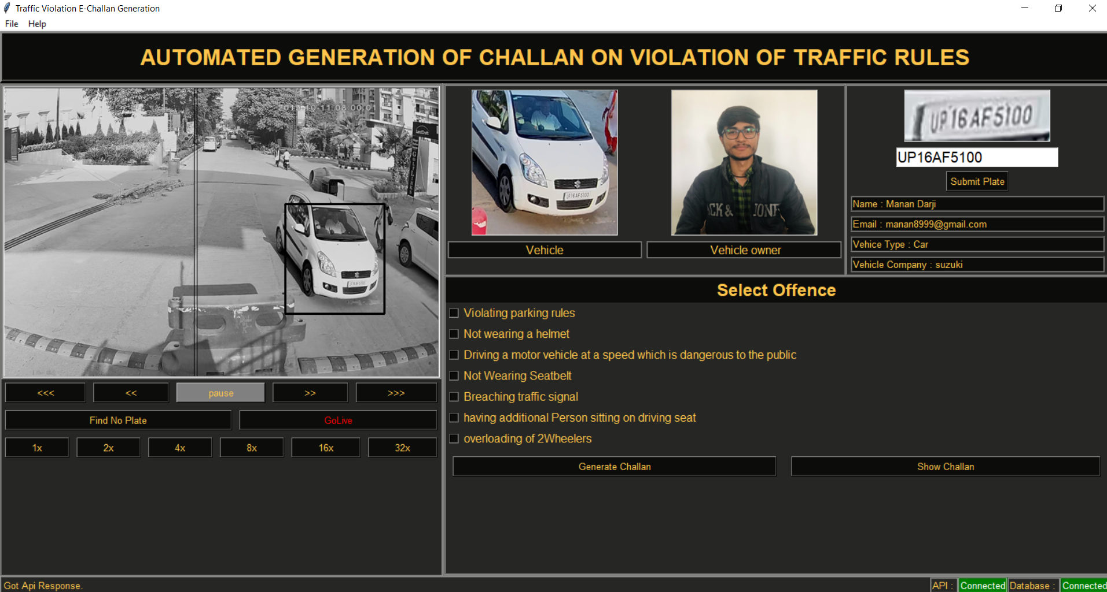
How to Use Software ?

Slide 2
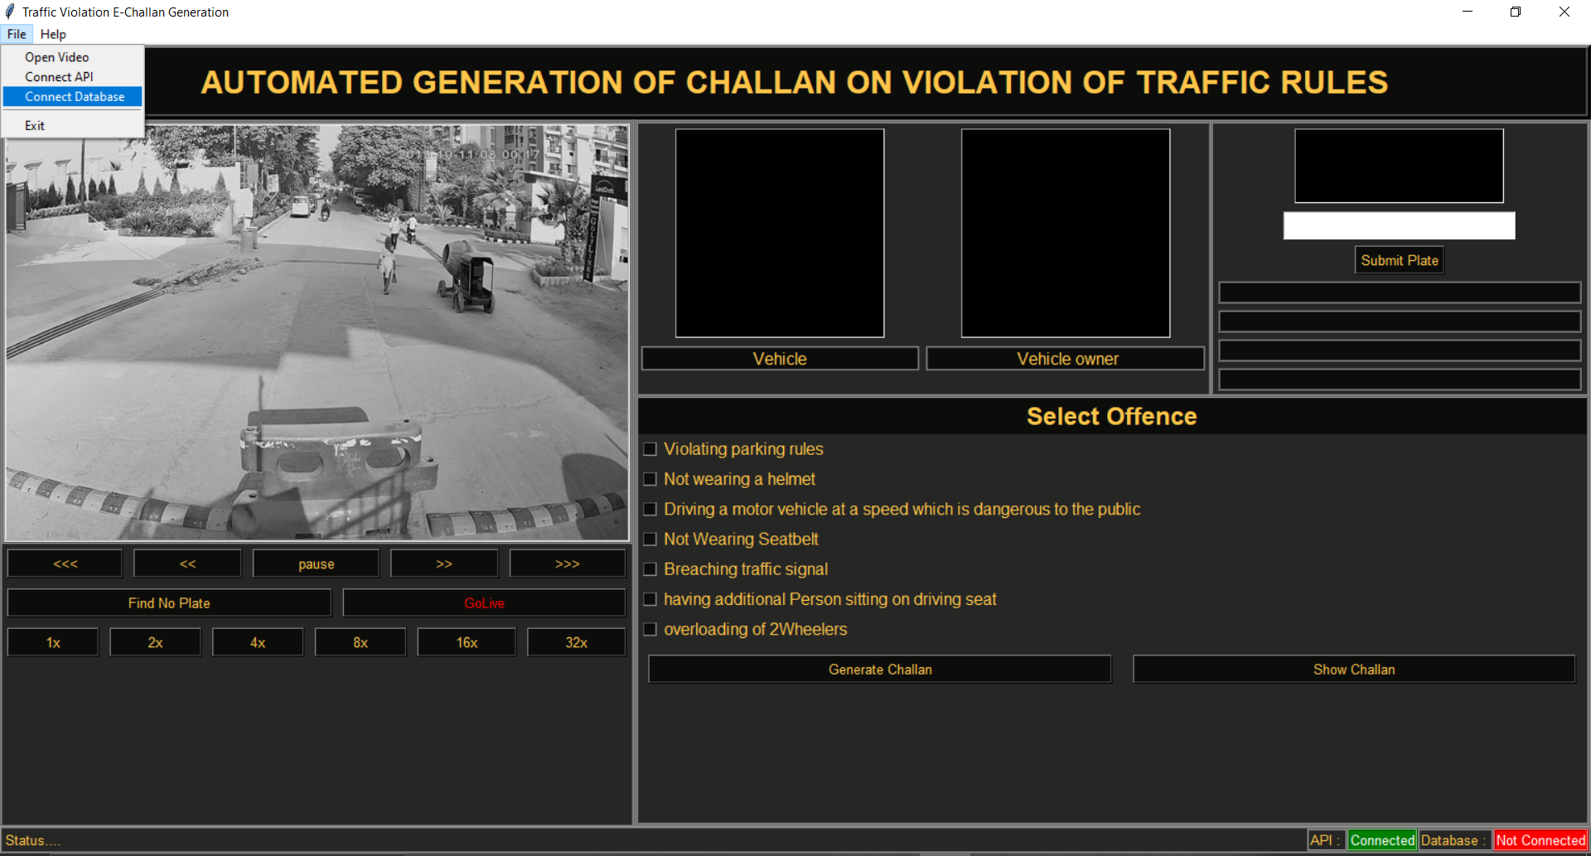
Menu For
Connect API/Database
Open New Videos
Cropped No Plate
Predicted No Plate
Video Frame
Video Control Panel
Data From Database
Status Bar
Connection Status
Select Offence

Slide 3
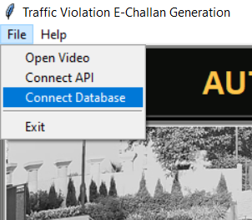
Step 1 : Connect API & Database

Slide 4
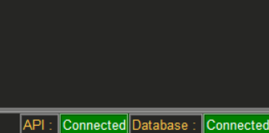
Step 2 : Check API & Database Status
If Not Showing Connected Then try again
Might be Internet Issue.

Slide 5
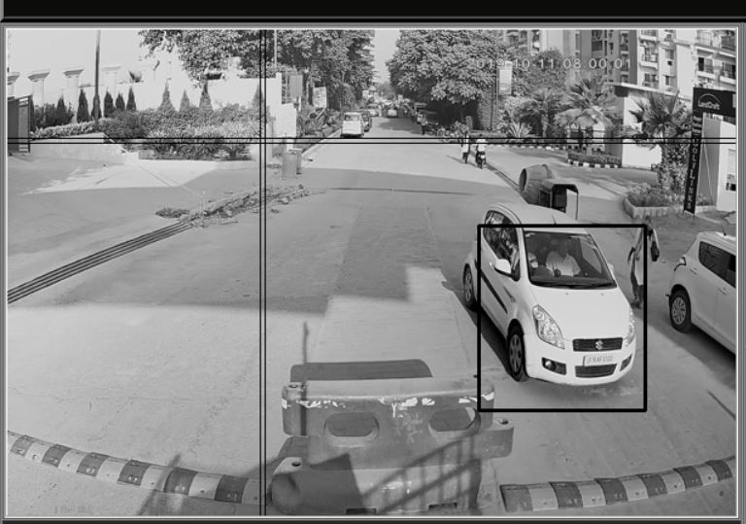
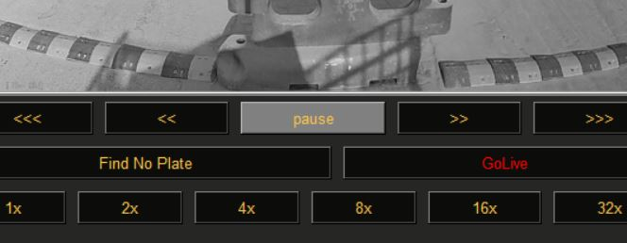
Step 3 : Pause Video and Select Vehicle
Hold Mouse Left Click And Drag to draw Box
Note : can not Draw on video while video is playing. Pause Video First

Slide 6
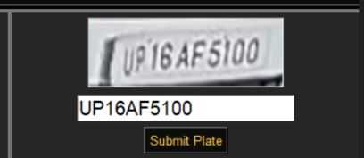
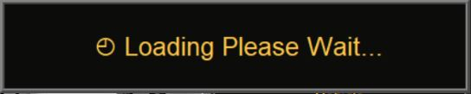
Step 4 : Click On Find No Plate Button and Wait
Cropped Plate
Predicted Plate
( if plate number is wrong correct it)
Note : Number Must be Available in DATABASE.

Slide 7
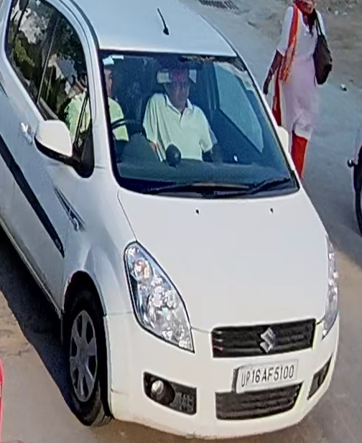
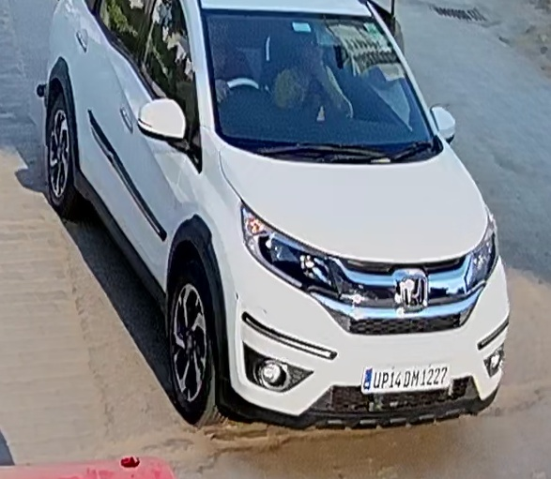
This 2 Vehicle added in database

Slide 8
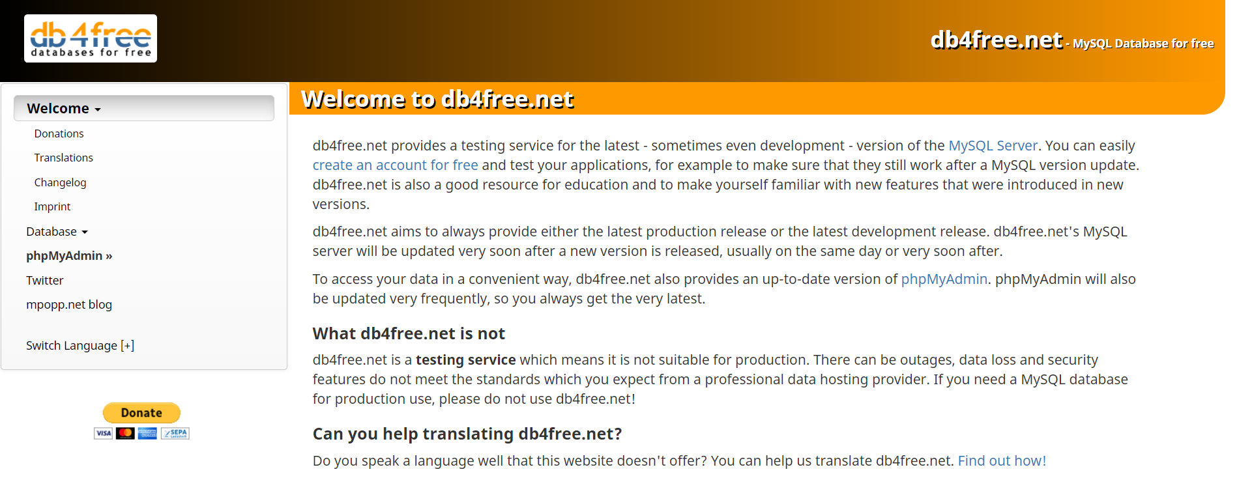
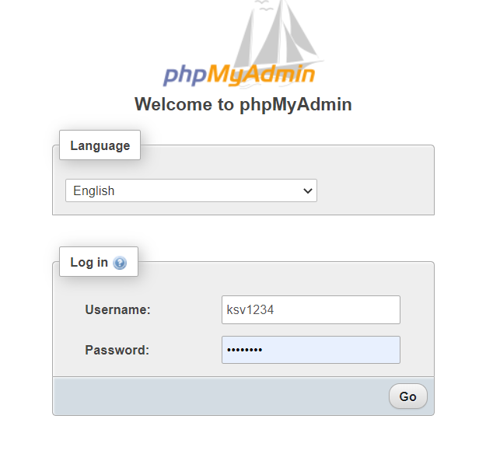
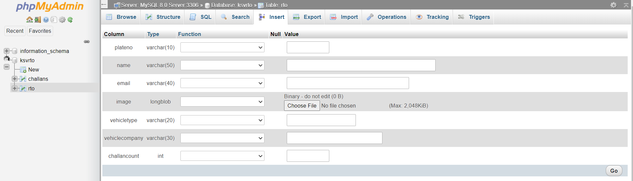
To add new vehicle
1.
Go to : db4free.net
Go to : PhpMyAdmin section
Login with
Insert new vehicle
Username :ksv1234
password :ldrp-itr
Go to rto table
Insert new vehicle
2.
3.

Slide 9
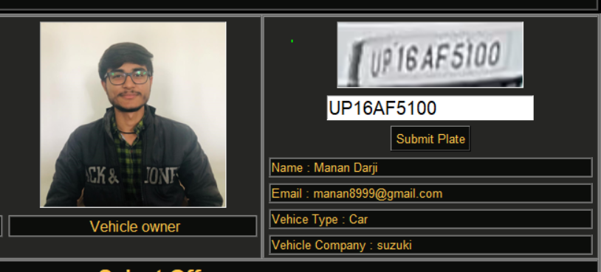
Step 5 : Click On Submit Plate

Slide 10
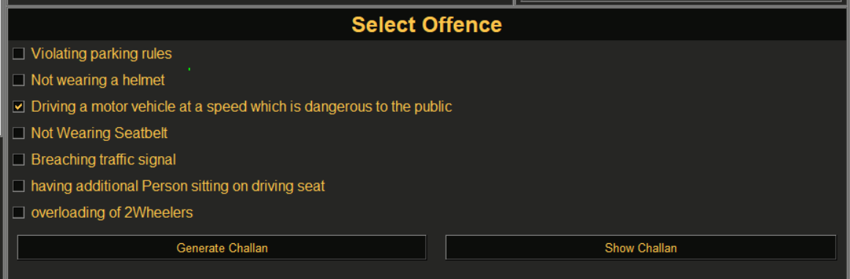
Step 6 : Select Offence And Click On Generate Challan

Slide 11
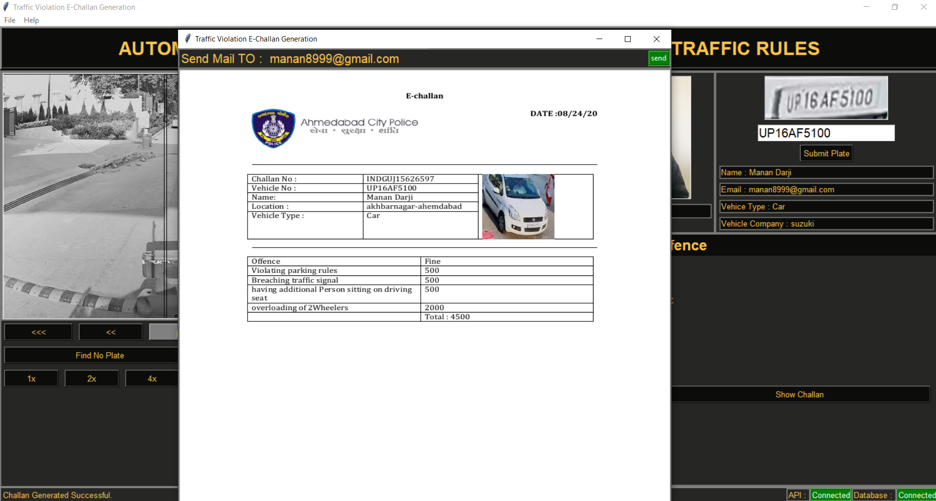
Step 7 : Verify Mail-Id And send Mail

Slide 12
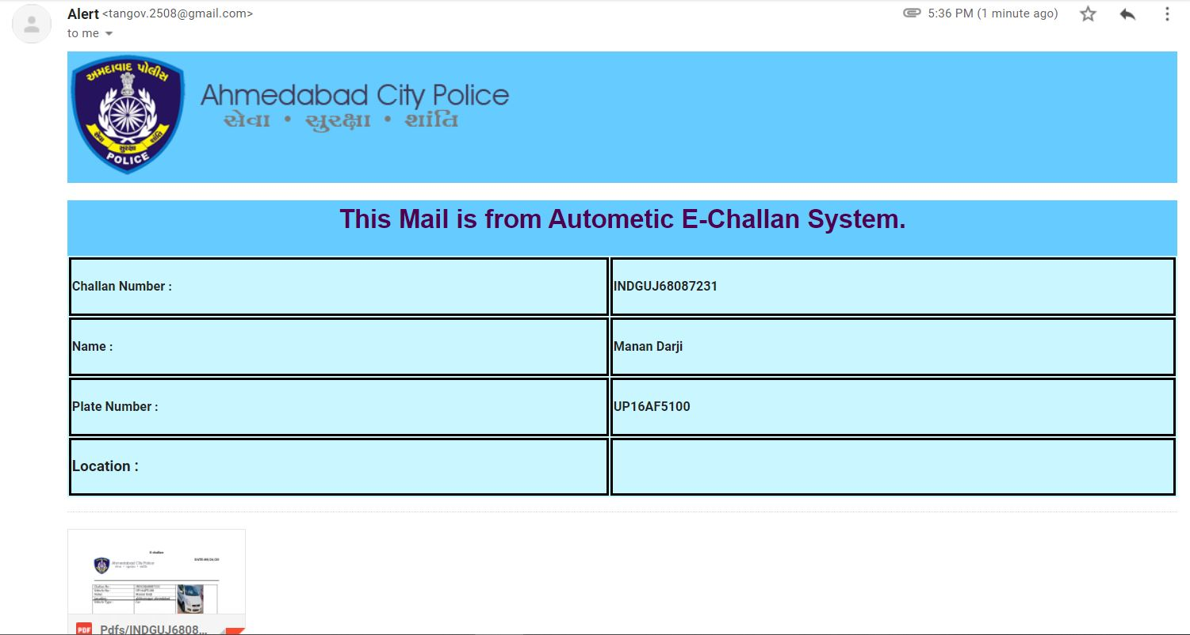
Step 7 : Check Mail

